Slide 1
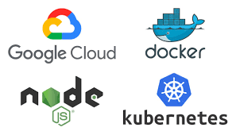
DEPLOYING A DOCKERIZED APPLICATION WITH KUBERNETES ON GOOGLE CLOUD PLATFORM
Presented by
Sahana B
Under the Guidance of

Slide 2
Agenda
Introduction.
Problems before Docker
Traditional v/s Docker.
Docker-Docker Engine , Architecture , Dockerfile .
Kubernetes-Objects , Features , Architecture, RS,RC And Deployment.
Google Kubernetes Engine
Implementation.
Proposed System Architecture.
Experimental Results.
Conclusion.
Future work.
References.

Slide 3
Introduction
With the advent of 5G, more and more devices will be connected, which requires careful monitoring especially in crucial situations such as transport scenarios.
The implementation of a web application based on microservices, each of them running in a dedicated Docker container, which gathers information in realtime from two vehicles.
These standalone executable packages of software are orchestrated by Kubernetes and hosted on Google Cloud Platform.
The data used during the execution of the project is stored into a Cloud SQL instance.
All the necessary resources in order to build the project can be monitored with Stackdriver.

Slide 4
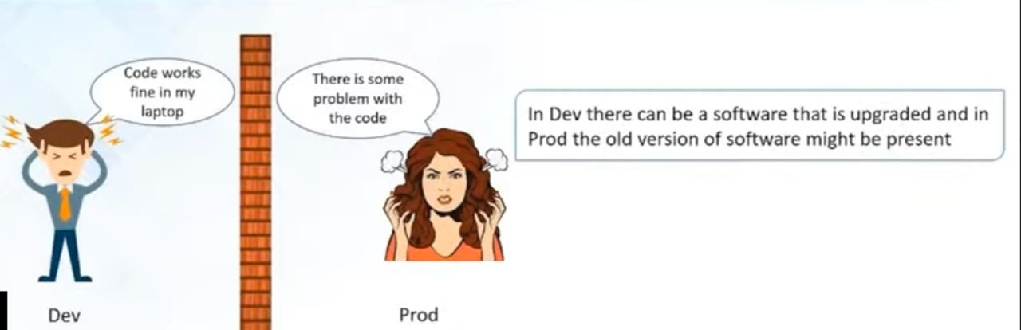
PROBLEMS BEFORE USING DOCKER
An Application works in developer’s laptop but not in testing or production . This is due to difference in Computing environment between Dev , Test and prod.

Slide 5
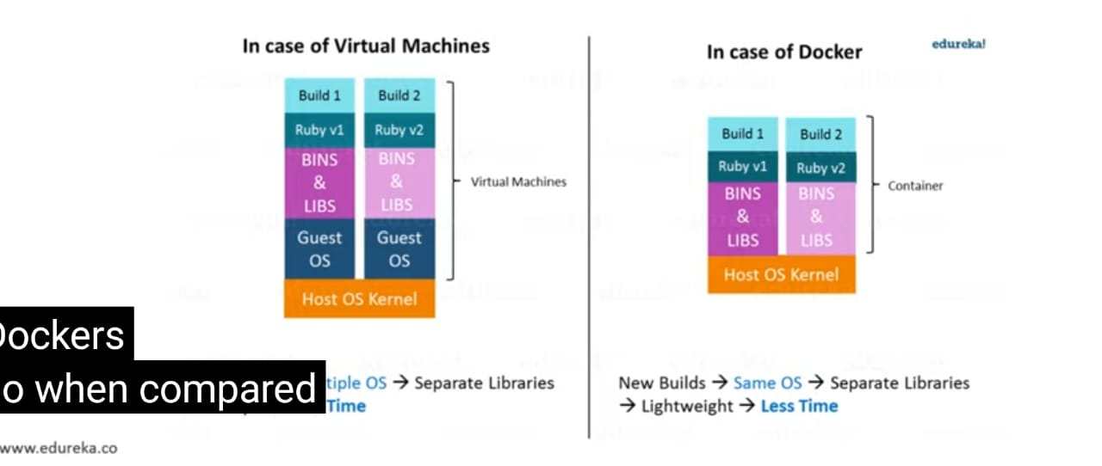
VM V/S DOCKER
New Builds Multiple OS Separate Library Heavy More Time
New Builds Same OS Separate Library Light Weight Less Time

Slide 6
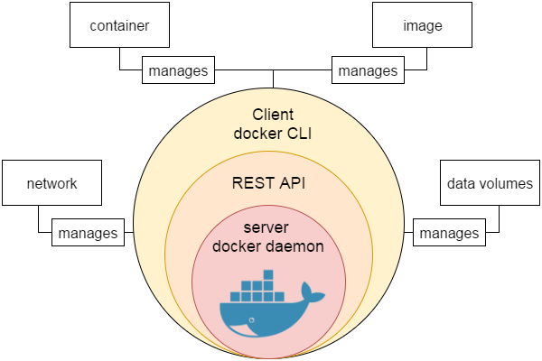
Docker Engine
It is a client server application that contains the following major components.
A server which is a type of long-running program called a daemon process.
The REST API is used to specify interfaces that programs can use to talk to the daemon and instruct it what to do.
A command line interface client
Docker daemon: Docker daemon runs on the host operating system. It is responsible for running containers to manage docker services. Docker daemon communicates with other daemons . It offers various Docker objects such as images, containers, networking, and storage.

Slide 7
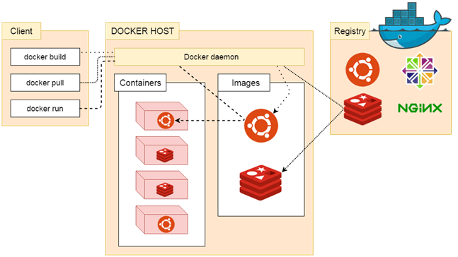
Docker Architecture
Three main components
Docker Client,
Docker Client uses Command Line Interface (CLI) to run the following commands
docker build
docker pull
docker run
Docker Host,
Docker Registry.
Public Registry
Private Registry

Slide 8
Dockerfile to build nodejs application
FROM node:9-slim
WORKDIR /app
COPY . /app
CMD [“npm”,”start”]
$docker build –t nodeapp .
$docker run –it –p 9000:3000 nodeapp
$docker ps
$docker login
$docker tag nodeapp sahanab/nodeapp
$docker push sahanab/nodeapp

Slide 9
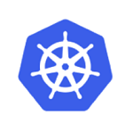
Kubenetes
Key Objects
Pod
Node
Service
Replicaset
ReplicationController
deployment

Slide 10
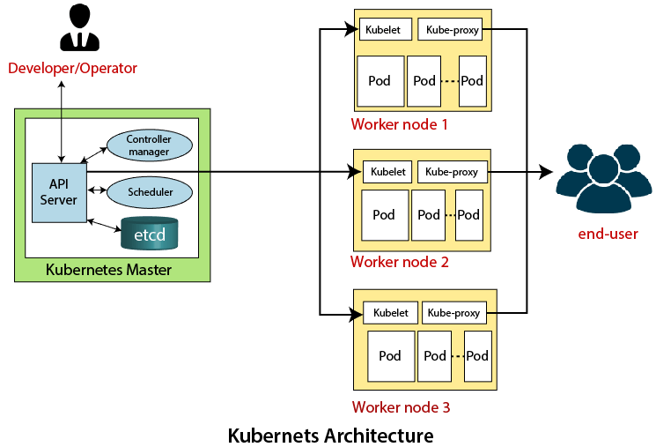
kubernetes Architecture
Two main components
Master Node (Control Plane)
API Server
Scheduler
Controller Manager
ETCD
Slave/worker node
kubelet
kubeproxy
pod

Slide 11
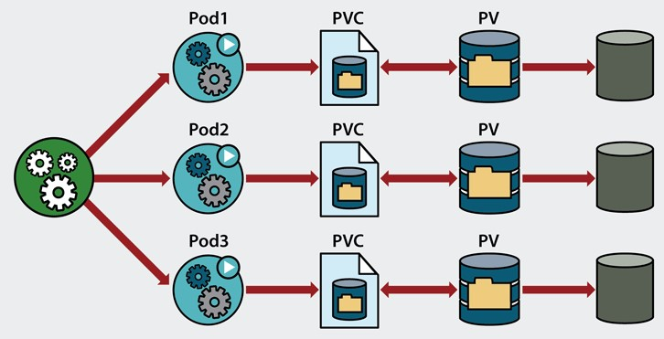
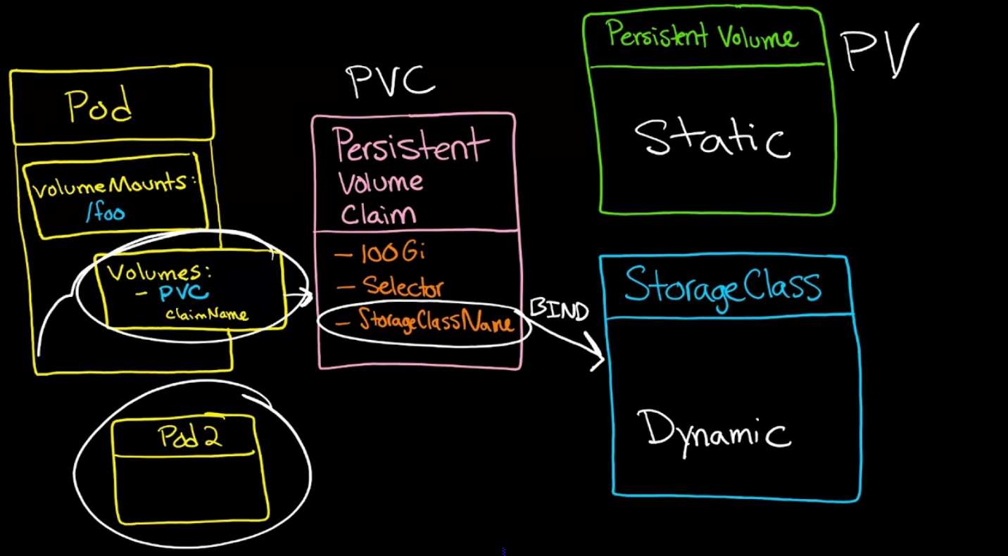
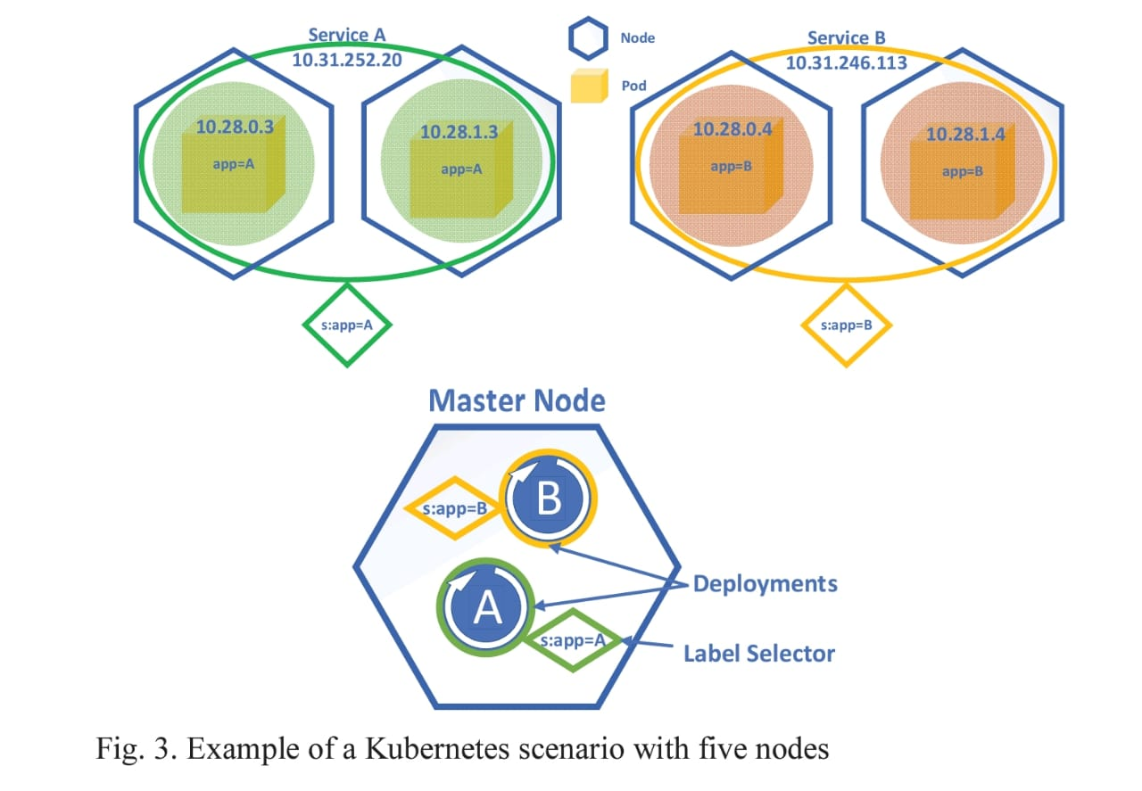
Kubernetes storage

Slide 12
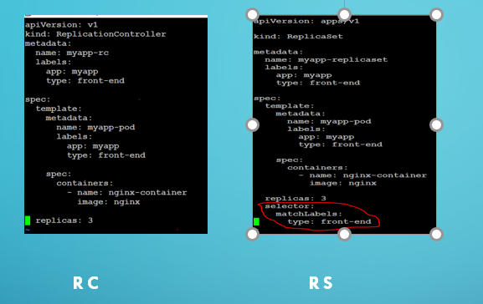
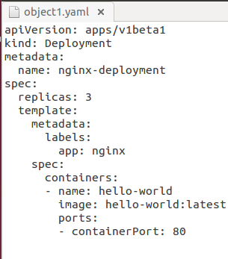
REPLICATIONCONTROLLER,REPLICATIONSET AND DEPLOYMENT

Slide 13
Google Kubernetes Engine
Secured and fully managed Kubernetes service with revolutionary autopilot mode of operation.
Start quickly with single-click clusters and scale up to 15000 nodes
Leverage a high-availability control plane including multi-zonal and regional clusters
Eliminate operational overhead with industry-first four-way auto scaling and release channels
Secure by default, including vulnerability scanning of container images and data encryption
Integrated Cloud Monitoring with infrastructure, application, and Kubernetes-specific views

Slide 14
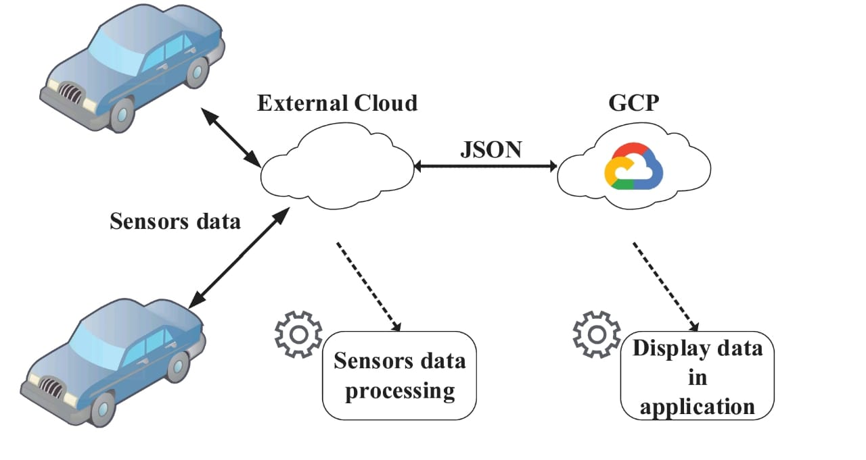
Implementation
Vehicle tracking is a microservice-based application called Crashalytics containerized with Docker, hosted on Google Cloud Platform and deployed with Kubernetes.
Vehicle tracking is a microservice-based application called Crashalytics containerized with Docker, hosted on Google Cloud Platform and deployed with Kubernetes.
Two cars that have sensors connected to a gateway.
Fig 4.Testbed architecture
This one has an encrypted communication through SSL with the Cloud SQL instance and fetches information such as: user credentials, number of vehicles, models etc.
From here the data is sent in real-time to the application hosted in GCP.
The data for each car is retrieved based on an identifier.

Slide 15
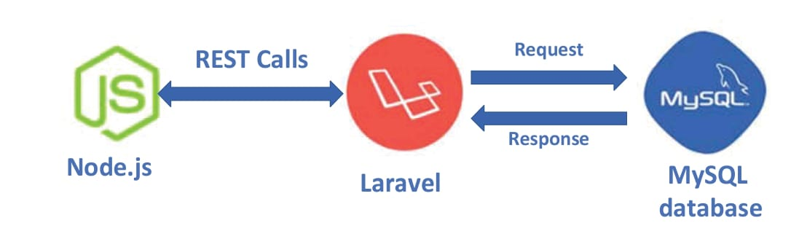
Fig Interworking of the three main components of the architecture
The solution consists of three main components
Backend microservice developed in PHP 7.2 using the Laravel framework;
A Cloud SQL instance for data storing;
A frontend microservice developed using Express which is a Node.js framework .

Slide 16
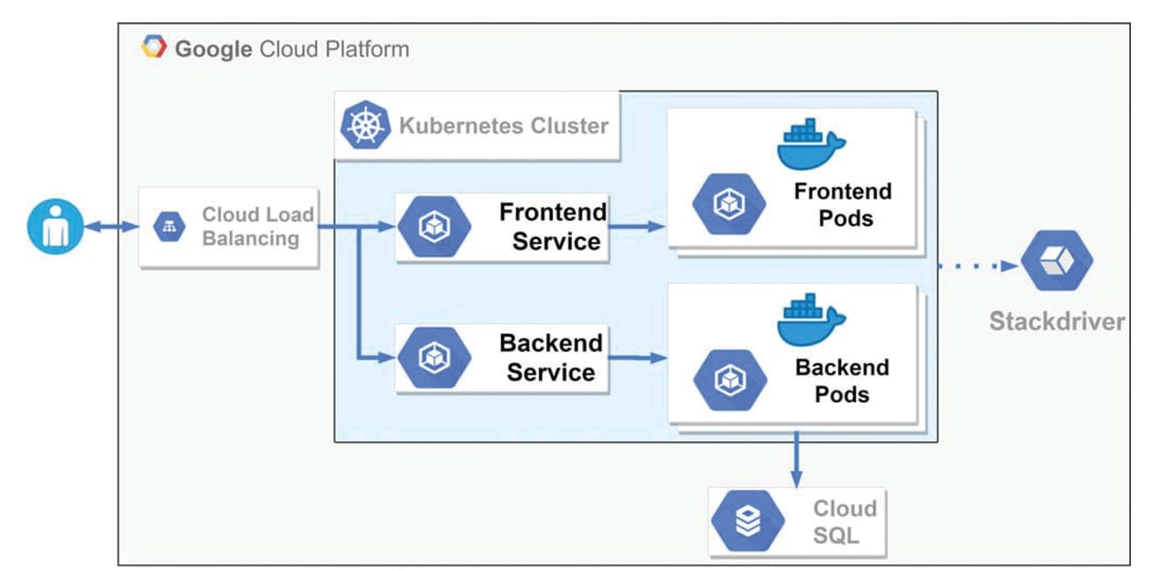
PROPOSED SYSTEM ARCHITECTURE
Fig .The Architecture Of The Adopted Solution

Slide 17
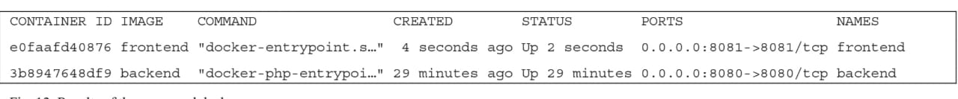
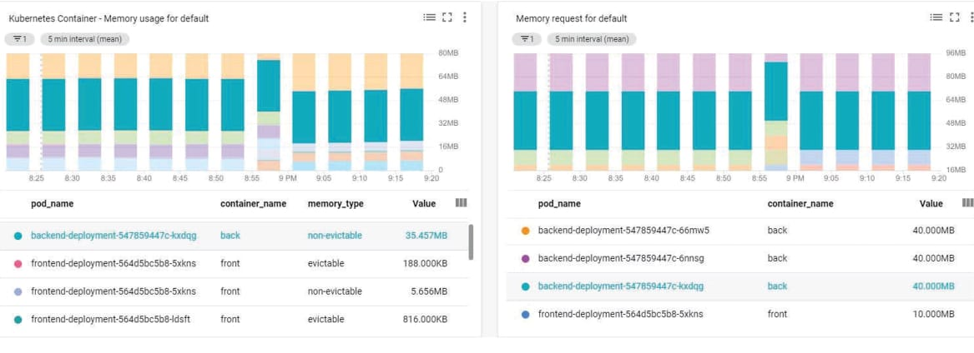
Experimental result
Fig 7.Result of the command docker ps
Fig 8.RAM memory usage by the containers versus the memory requested by default

Slide 18
CONCLUSION
By this we have evaluated a solution for monitoring vehicles in real-time using containerized applications.
For wide networks of connected vehicles, orchestrating these containers with Kubernetes could be a powerful solution. However, our work to evaluate the Docker performance and security is under progress.
The ability to orchestrate a large number of containers simultaneously is an important first step for deploying and managing such networks.

Slide 19
FUTURE WORK
As for future developments, it is intended to set up a Kubernetes cluster on a private cloud.
The cluster nodes will be made up of multiple Raspberry Pi platforms that will collect more sensor information.
Moreover, by configuring the Kubernetes cluster on bare-metal, the overall performance of the system is expected to improve.

Slide 20
REFERENCES
M. Lukša, “Kubernetes in action”, Manning Publications, 2017
K. Matthias, and S.P. Kane, “Docker:Up and Running”, O’Reilly, 2015
Google Cloud Platform Documentation, 2020, [Online], Available: https://cloud.google.com/docs/
Kubernetes Documenation, 2020, [Online], Available: https://kubernetes.io/docs/home/
Express - Fast, unopinionated, minimalist web framework for Node.js, 2020, Available: https://expressjs.com
C. Richardson, “Microservices patterns: With examples in Java” Shelter Island, NY: Manning Publications, 2019

Slide 21
THANK YOU

